Slide 1
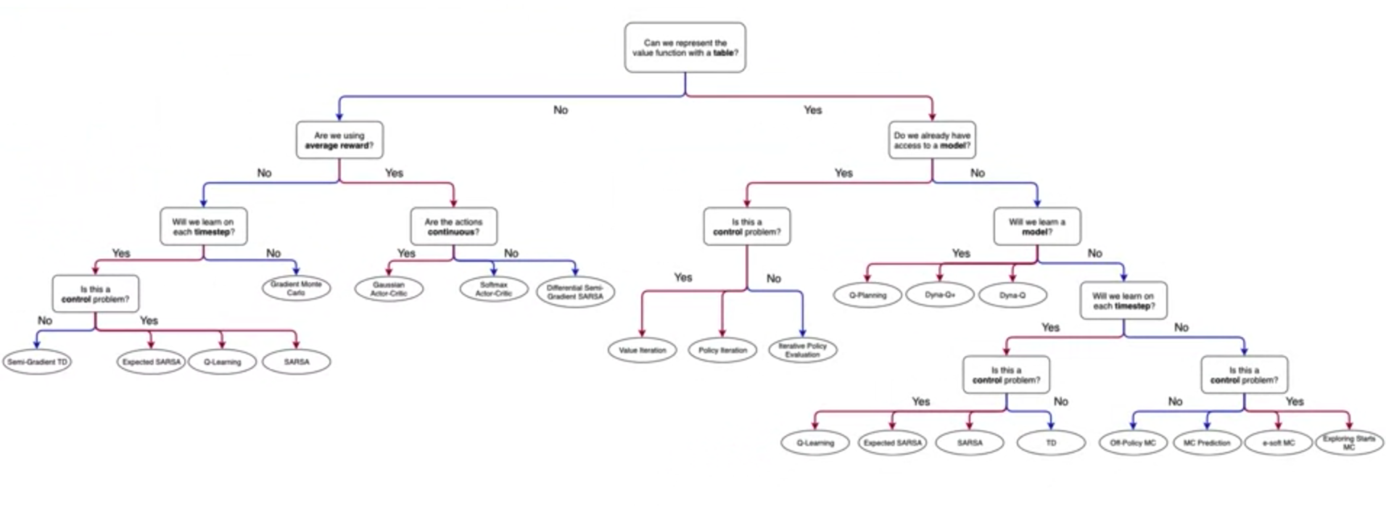

Slide 2
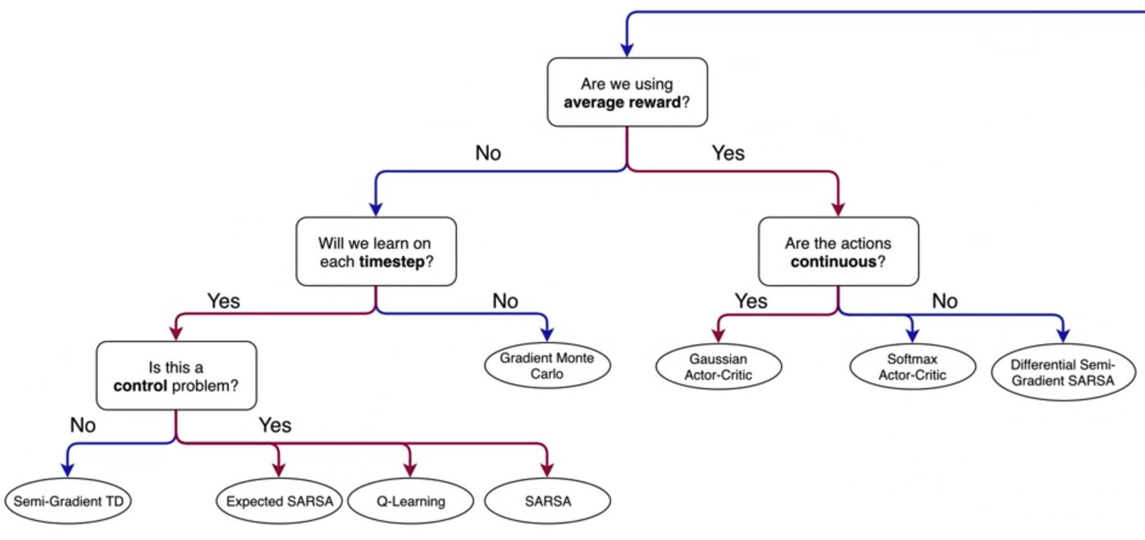
Can we represent the value function with a table?
No

Slide 3
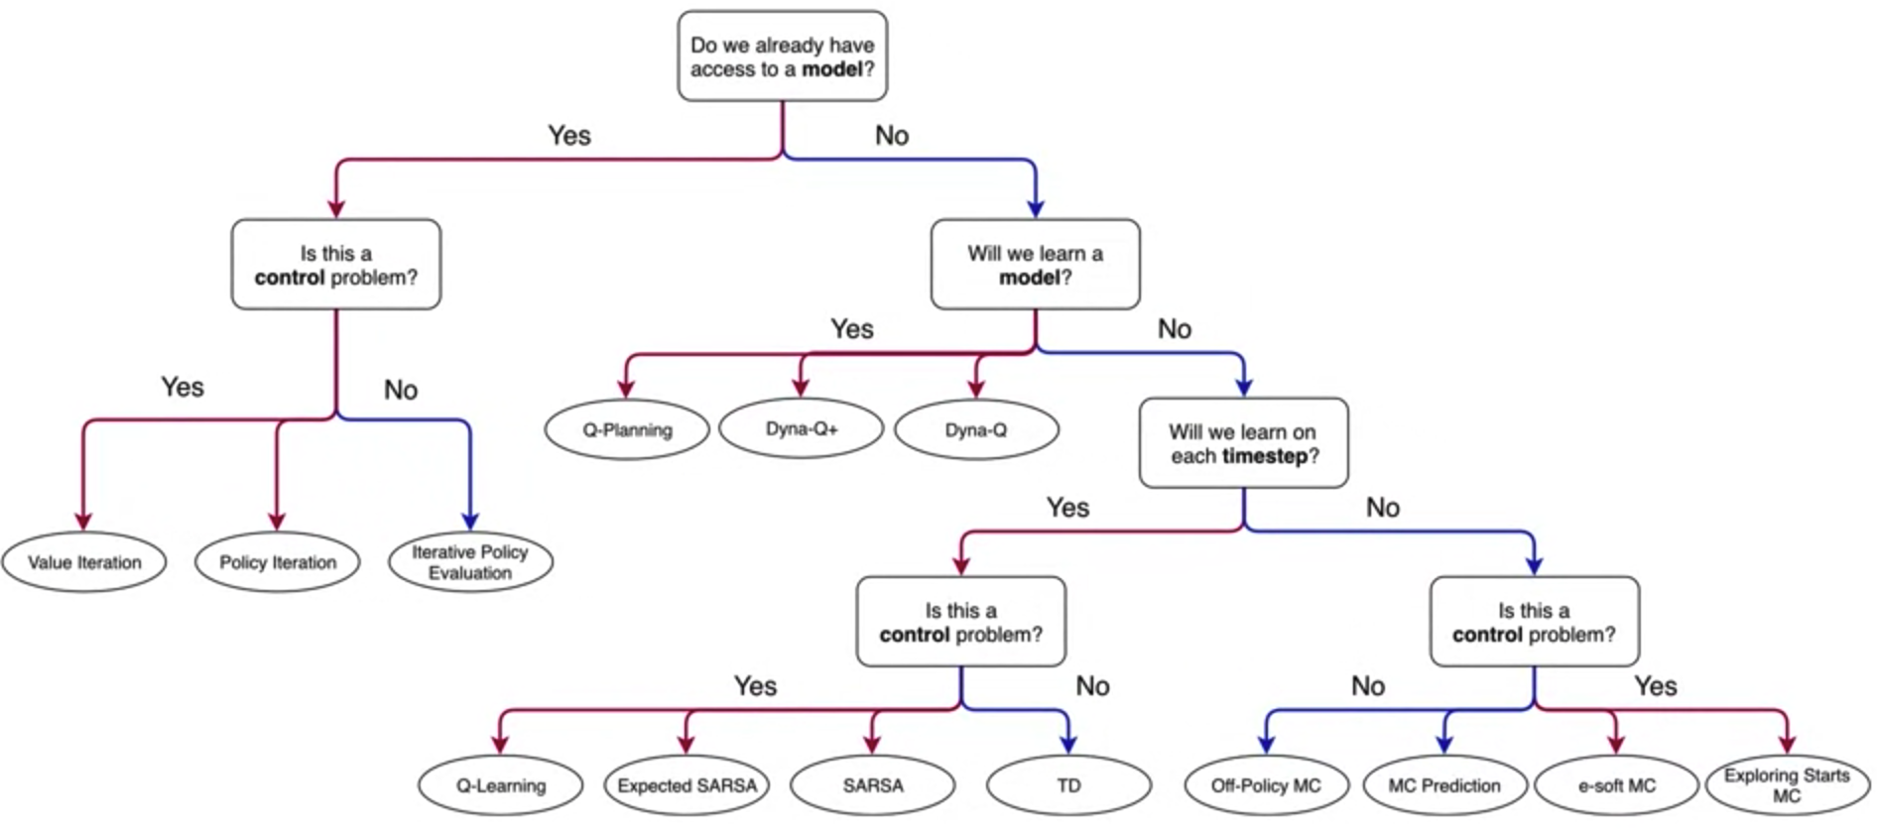
Can we represent the value function with a table?
Yes

Slide 4
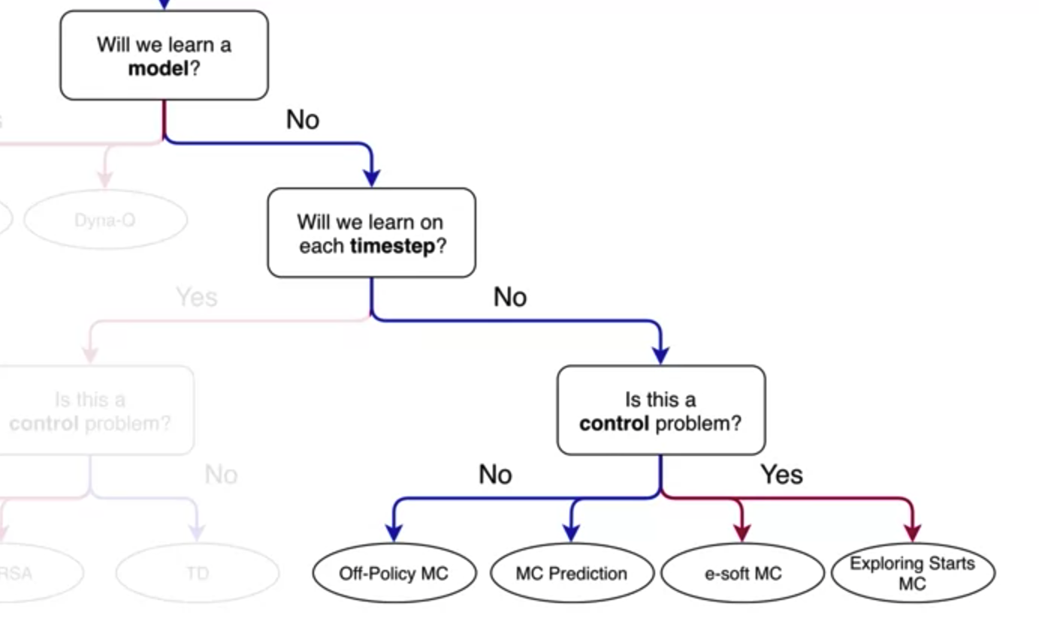

Slide 5
